Slide 1
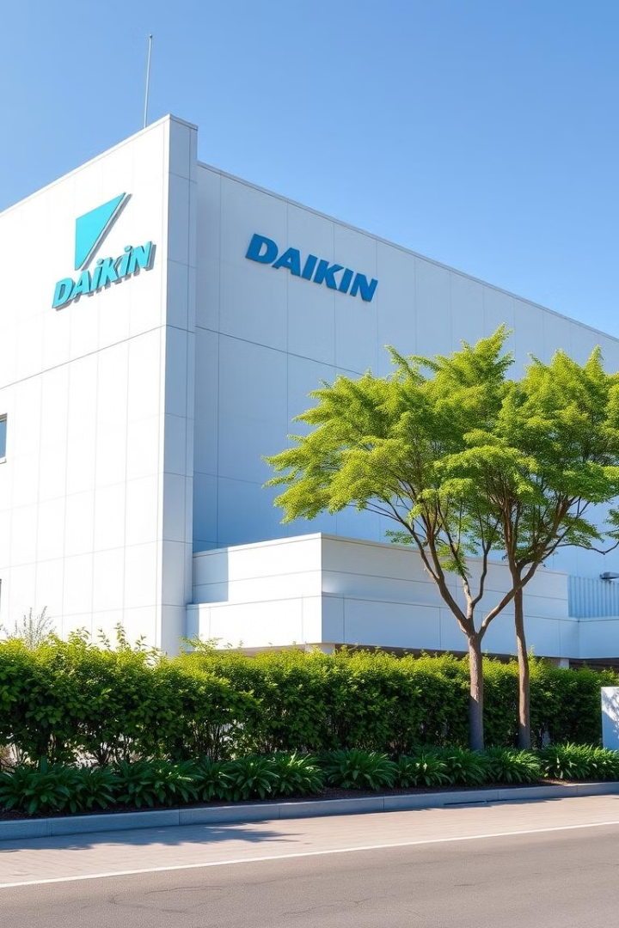

Industrial Visit to DAIKIN Industries
Observations & Learnings from our industrial visit to Daikin, one of the world's leading HVAC solution providers.
by Divyank Harjani

Slide 2
Introduction to DAIKIN Industries
Overview of Daikin
Global Presence
India Operations
Japanese multinational, HVAC solutions.
Operates in 150+ countries.
Manufacturing facilities in Neemrana, Rajasthan.
Established in 1924.
Headquarters: Osaka, Japan.

Slide 3
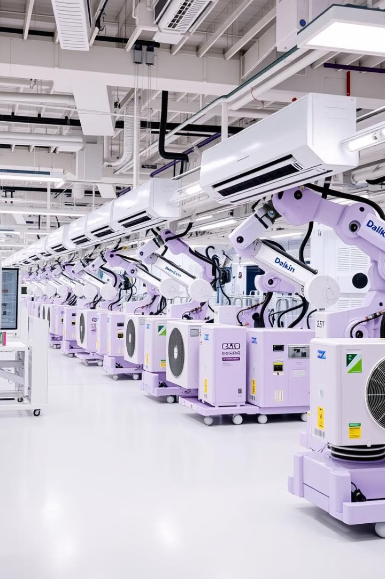


Industrial Visit Observations
Manufacturing Process
Raw material sourcing & supply chain.
Assembly line operations.
Quality control & testing.
Technology Used
IoT-enabled AC units.
AI-driven energy efficiency solutions.
Automated assembly systems.

Slide 4
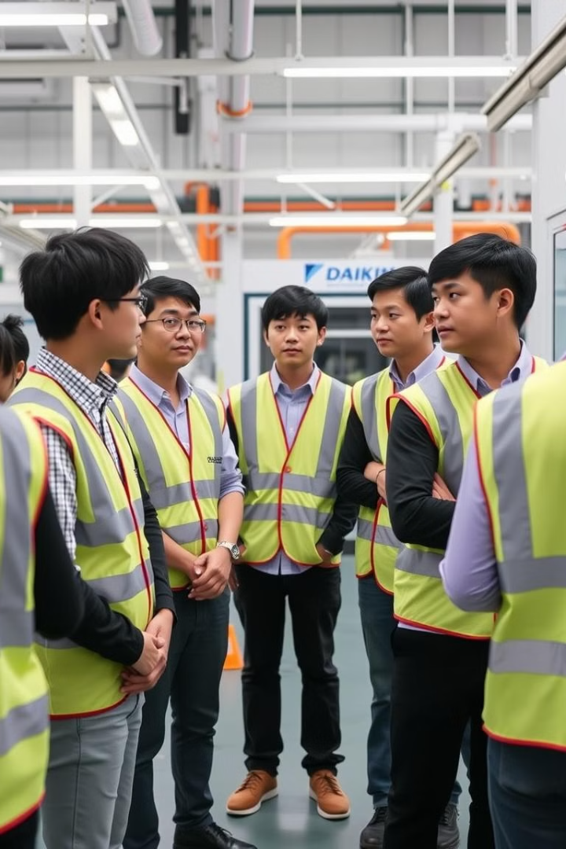
Learning Outcomes from the Visit
Production & Automation Insights
Sustainability & Green Manufacturing
Quality Assurance & Compliance Standards
Supply Chain & Logistics Optimization

Slide 5
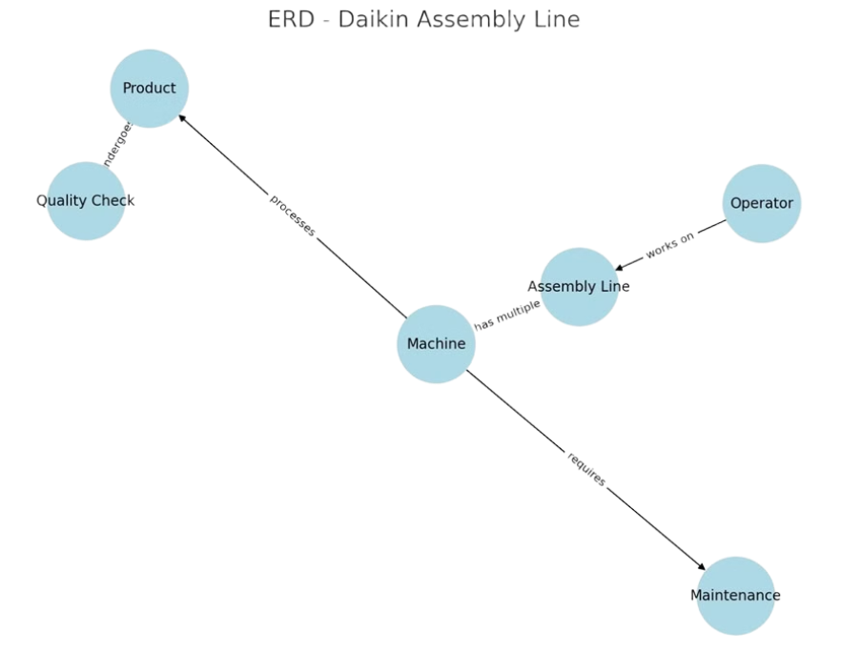
ERD for Daikin’s Supply Chain
Entities and relationships in Daikin's supply chain.

